Slide 1

TASK-06
PRODUCT :
APP TAXI APPILICATION

Slide 2
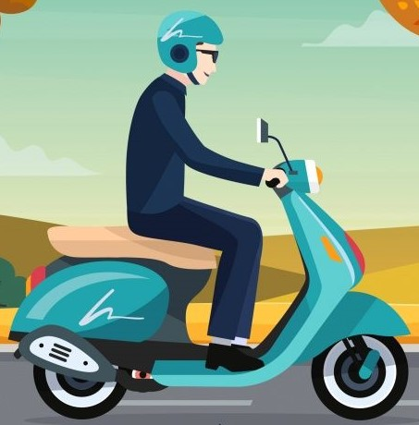
INTRODUCTION
A ridesharing company, ride-gailing service , (the vechile are called app-taxis or e-taxis) is a company that , via websiyes and mobile apps, matches passenges with drivers of vechikes for hire that, unlike taxis, cannot legally be hailed from the street.

Slide 3
TITTLE : SAFETY RIDOS
SCENE #1
HOME SCREEN :
Sam , who is a graduating student has a transport problem , decides to download
SAFETY RIDOS for her daily basis . After downloading, the app asks the user to login with her personal details like phone No. followed by OTP . The home screen displays several offers for the first ride.

Slide 4
SCENE #2
RIDE DETAILS :
Sam explores the app then she selects the location of pickup and drop .She goes through the prices of provided transport facilities .As per her preference she books a bike for her college .

Slide 5
SCENE #3
TRIP DETAILS :
Then she chooses the mode of payment i.e( via online , cash …) and confirms the ride with safety ridos .

Slide 6
SCENE #4
DRIVER’S CONFIRMATION :
The driver near her location confirms her ride and reaches her at the pickup location. She then checks the vehicle details.

Slide 7
SCENE #5
RIDE STARTS:
Sam shares the OTP with the driver and she begins her safety ride with SAFETY RIDOS. According to the app rules, they provide helmet to the customers.

Slide 8
SCENE #6
RIDE ENDS:
Sam reaches her destination safely. Then she completes her payment with the mode she chose. The app asks for rating the driver.

Slide 9
PLOT :
1) Sam downloads SAFETY RIDOS app
2) Then she logged in
3) She selects her location
4) She selects the vehicles
5) Then starts her journey
CHARACTER :
1) Sam (user)
2) Safety Ridos

Slide 10
THANK
YOU
TEAM CRITICAL THINKERS
T.RISHIKA
K.VAISHNAVI
V.MANASWANI
V.TEJASWINI
Y.AVANTHIKA

